Slide 1
Innovative test solution
Provider
- Probe pin Datasheet -

Slide 2
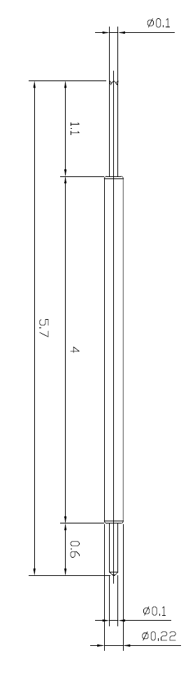
※ General POGO pin – 5.7mm / 0.3P
IVB-DCR-570-022-A222-00
Pitch | 0.5mm
Total Length | 5.7mm
Use Length | 5.2mm
Use Stroke | 0.65mm
Spring Force at Use Stroke | 10gf at 0.65mm Stroke
Operating Temperature | -40 to 150°C
DC Resistance | Under 100.0mΩ at 0.65mm stroke
Current Rating | 0.5A (Continuous)
Self Inductance | TBD
Bandwidth @ -1dB | TBD
Top Plunger | BeCu / Au over Ni
Bottom Plunger | BeCu / Au over Ni
Barrel | BeCu / Au over Ni
Spring | Stainless Steel / Au
Insertion Life | 100,000 cycles at 0.65mm Stroke

Slide 3
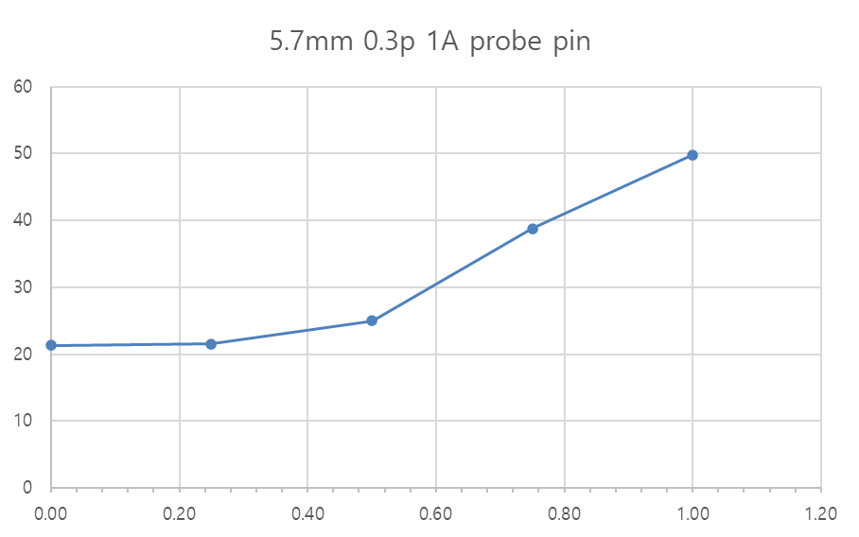
※ General POGO pin – 5.7mm / 0.3P
5.7mm 0.3p
Current (A) | Temp. (T)
0.00 | 21.3
0.25 | 21.5
0.50 | 25
0.75 | 38.8
1.00 | 49.8

Slide 4
Thank you.

